Slide 1
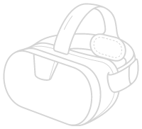
What is Metaverse

Slide 2
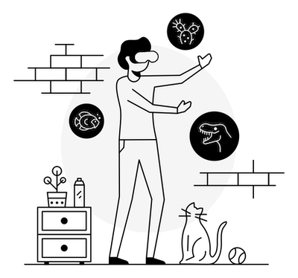
The metaverse comprises many technologies, such as virtual, augmented reality, AI, Web3, and more. It's one, two, and three-dimensional. It's interactive and non-interactive. It's virtual and physical, and it's expanding every day.
It isn't one specific type of technology. Its many technologies have led humanity to a more significant way of communicating and expressing.
The metaverse is a virtual ecosystem of communication and interaction, and we, as a global society on earth, have been contributing to its great development for decades now. If you've ever played a videogame, you've ever used a mobile phone, if you've ever watched television, published a book, or even sent a message on social media, you've participated in some way towards the evolution of the metaverse itself.

Slide 3
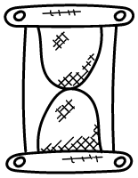
Over the past several decades even before the 80s, the conceptual metaverse was being imagined, a way for human beings to interact and communicate into virtual spaces. And not just communicate, but to create, build, collaborate, work and even live in.
Now regarding the history of the metaverse, we could jump all the way into the 1990s that could lead us up to a novel called “Snow Crash” written by Neal Stephenson, who actually coined the name, the metaverse in 1992, which is a book filled with technology, history, politics, cryptography, philosophies, and so much more.
History

Slide 4
Over the past 20 years, the single greatest technical achievement of mankind has been the rapid advancement of communication. We've never had more ways to communicate with one another than we do now.
Right now, there are thousands of teams of individuals creating new virtual constructs to place in the market. 3D artists and photogrammetry experts are designing and filming for known virtual worlds.
At some point, every industry in the world will be influenced by the metaverse. There will not a single industry escape it.
History

Slide 5
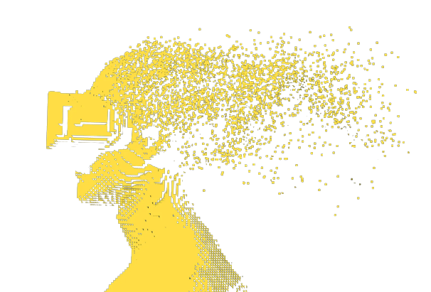
Use Case
In education, It's time to go further that bring us to Virtual Reality. The future of education, digitally, to me, looks like immersive teleportation systems in which students from around the world can come together to congregate. Where a teacher is no longer limited to the space and size of their classrooms, but could arguably teach a class in VR with over 100,000 students from around the world in real-time in attendance.

